Slide 1
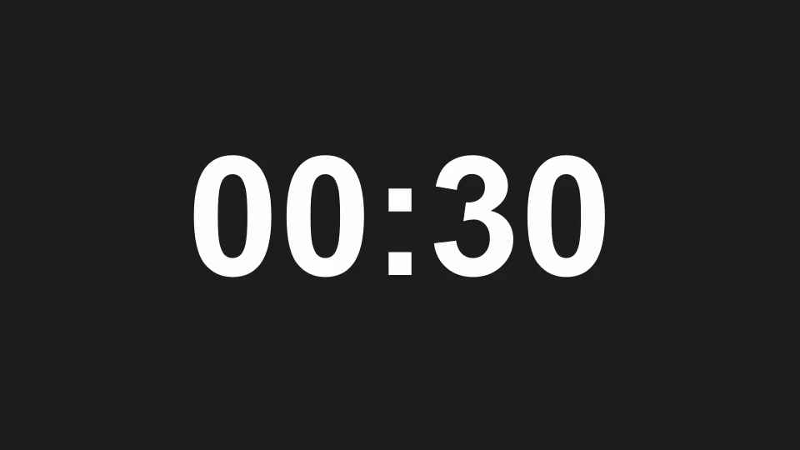
Question 1 of 3
Which number is 6 × 7?
A. 36
B. 42
C. 48
Write down A, B, or C.
30 seconds. Press Right Arrow to start.
Notes:
Question 1: Which number is 6 × 7? Correct answer: B. 42. Read the question, then press Right Arrow to start the 30-second countdown. At zero, press Right Arrow again to reveal the answer slide. To customize the quiz, edit the question and choices and update the following answer slide.

Slide 2
Answer 1 of 3
B. 42
6 × 7 = 42.
Award 1 point for a correct answer.
Notes:
Question 1: Which number is 6 × 7? Correct answer: B. 42. Discuss the answer and move to the next question when ready.

Slide 3
Question 2 of 3
Which fraction equals one half?
A. 1/3
B. 2/3
C. 2/4
Write down A, B, or C.
30 seconds. Press Right Arrow to start.
Notes:
Question 2: Which fraction equals one half? Correct answer: C. 2/4. Read the question, then press Right Arrow to start the 30-second countdown. At zero, press Right Arrow again to reveal the answer slide. To customize the quiz, edit the question and choices and update the following answer slide.

Slide 4
Answer 2 of 3
C. 2/4
Dividing 2 and 4 by 2 gives 1/2.
Award 1 point for a correct answer.
Notes:
Question 2: Which fraction equals one half? Correct answer: C. 2/4. Discuss the answer and move to the next question when ready.

Slide 5
Question 3 of 3
How many minutes are in two hours?
A. 120
B. 90
C. 60
Write down A, B, or C.
30 seconds. Press Right Arrow to start.
Notes:
Question 3: How many minutes are in two hours? Correct answer: A. 120. Read the question, then press Right Arrow to start the 30-second countdown. At zero, press Right Arrow again to reveal the answer slide. To customize the quiz, edit the question and choices and update the following answer slide.

Slide 6
Answer 3 of 3
A. 120
2 × 60 minutes = 120 minutes.
Award 1 point for a correct answer.
Notes:
Question 3: How many minutes are in two hours? Correct answer: A. 120. Discuss the answer and move to the next question when ready.

